Slide 1
Machine Learning made easy: Intel® and GCP*
Priyanka Bagade - Technical Evangelist
Martin Kronberg – Technical Evangelist
*Other names and brands may be claimed as the property of others.
Notes:
Hello and thank you for coming! My name is Priyanka Bagade and today I want to talk to you about machine learning. Specifically we will look at how Google cloud APIs for machine learning has improved accuracy in speech recognition and text analysis and then share a demo of it in action!

Slide 2
Outline
Intro
Intel IoT Overview
GCP Overview
Speech to Text
Text Analysis
Demo!

Slide 3
Intel IoT Overview
Notes:
Before I get into the details of how these systems work and how we can use them together I want to give you guys an overview of both Intel and Google – the Edge and the Cloud.
First Intel – the hardware at the edge- what is their place in the IoT ecosystem?

Slide 4


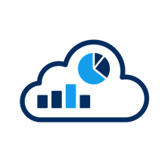




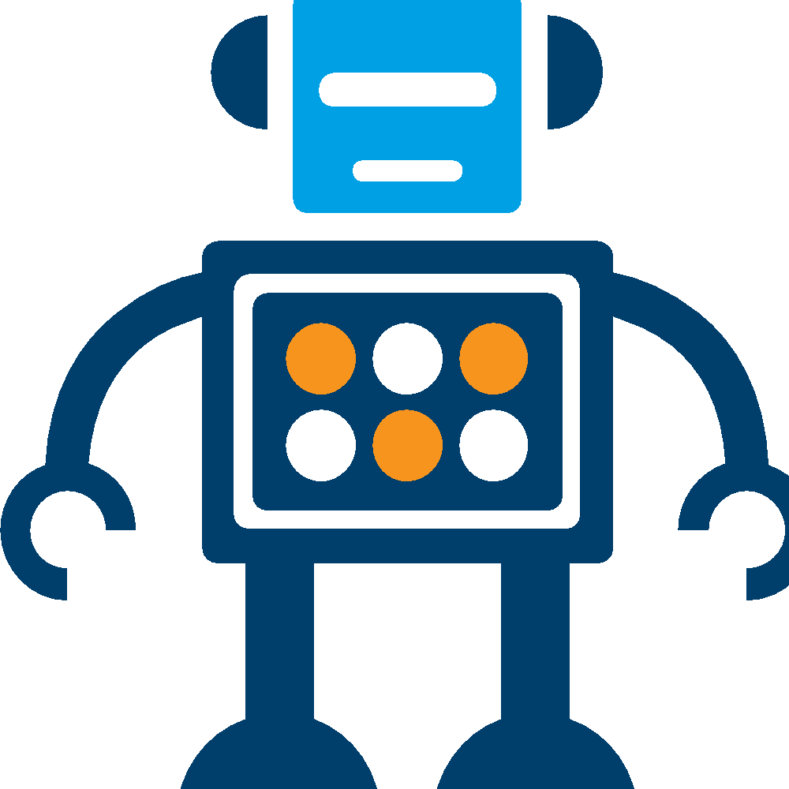
Intel® Architecture Powers Endpoints, Gateways, Networks, and Cloud
NETWORK
(DATA CENTER)
THINGS (ENDPOINTS)
GATEWAY
CLOUD-BASED ANALYTICS
The Intel® IoT Platform: A blueprint for connecting devices into the cloud for developers to better leverage data, customize, and scale
4
Notes:
Overview of Intel IoT Architecture:
The Intel® IoT Platform enables you to move IoT from pilot to mainstream deployment with a repeatable foundation of building blocks and technology ingredients that can be customized for limitless solutions.
The Intel IoT Platform provides a blueprint for connecting devices into the cloud while promoting scalability, interoperability, and security across the entire IoT solution—enabling developers to leverage IoT data in real time, as well as customize and scale the solution. It has the following main parts:
- Start: Things – Sensors, Actuators – webcams, temperature, light, servos, etc.
- Finish: Cloud Based Analytics – Deep Learning, Predictive Maintenance, Big Data - Google
- Well technically the finish is deciding what actions to take from the analytics, but Intel can’t help you there.
- How do we get from start to end? Intel Gateways and Google servers.
- Things need a way to talk to the data center. They often don’t have a built in internet connection. They use serial protocols like modbus, I2C, short range radios like bluetooth, zigbee, zwave. By connecting over those protocols to a gateway the things have a way of communicating to the data center.
By acting like a central data hub, the gateway can also accomplish a few other important functions. Even if the things could communicate to the internet on their own, that’s not a schema that you would want to use. Dealing with that number of individual connections is going to be pretty inefficient and really insecure. More connections is going to means larger surface area for any kind of malicious attacks. So minimizing the number of connections is going to go a long way to help your iot deployment be more secure.

Slide 5
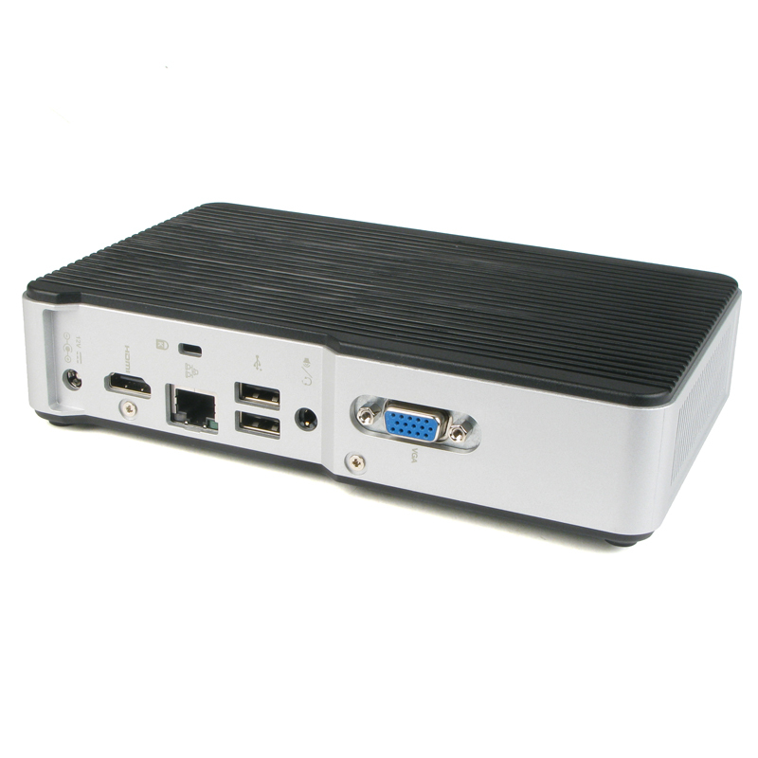
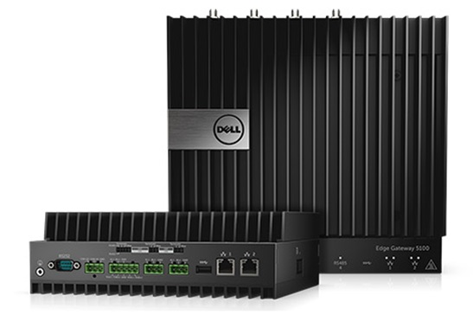
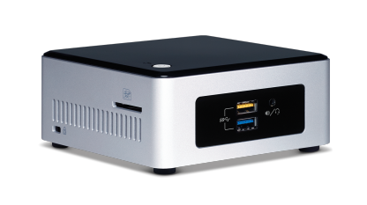
Intel® NUC Gateway
Scalable
Open Source
Wide Range of Specifications
Notes:
Specifically when I talk about Intel Gateways I am referring to the NUC Gateway. A NUC is a ”Next Unit of Computing” a term coined by intel to which refer to a series of small, customizable PCs which come in a wide range of specifications. The specifications range from lightweight prototype devices meant for a simple smart home system, all the way up to a hardened commercial grade device with industrial I/O running on the latest generation i7.

Slide 6

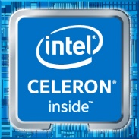
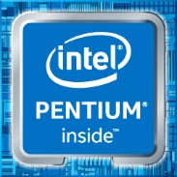
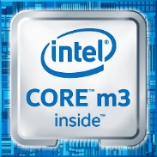
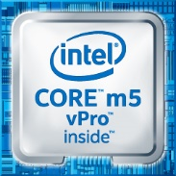

Scalable Processing
From Intel® Atom® to Intel® Core™ i7
Get just the right amount of compute power at the edge
Notes:
Just the right amount of compute power – find a balance between power requirements, heat, cost.
Since all of the processors use the same x86-64 architecture you can shift from one platform to another without having to worry about architecture compatibility.

Slide 7



Open Source Technology
MRAA
Notes:
Intel IoT is based on open source technology. All of our libraries, code samples, and operating systems are open source.
For instance on this gateway we are running Ubuntu 16.04
In short having open source technology means that you get better interoperability by working across other open source platforms.
Also as you are developing your project you can pull whatever pieces of code you need from our repositories, use what you need, and not worry about licensing later on.

Slide 8
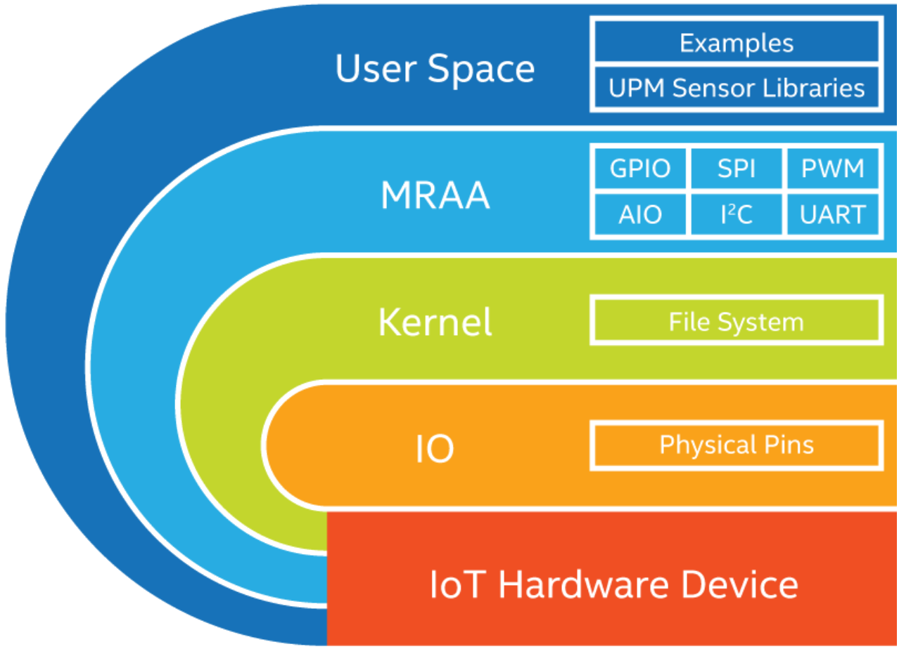
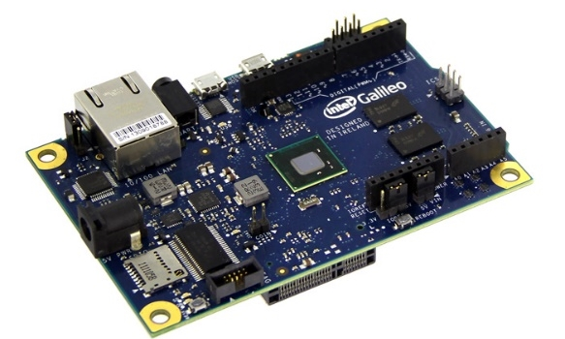
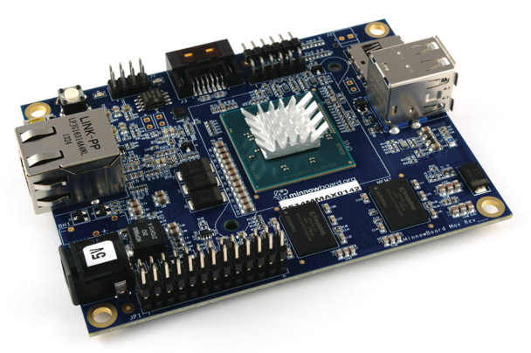
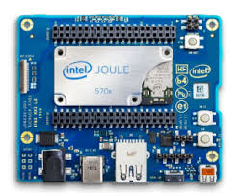
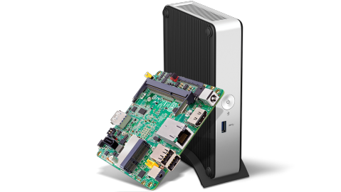
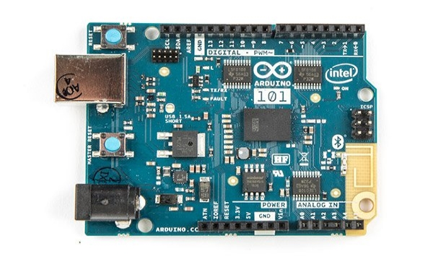
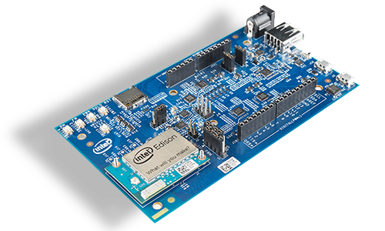
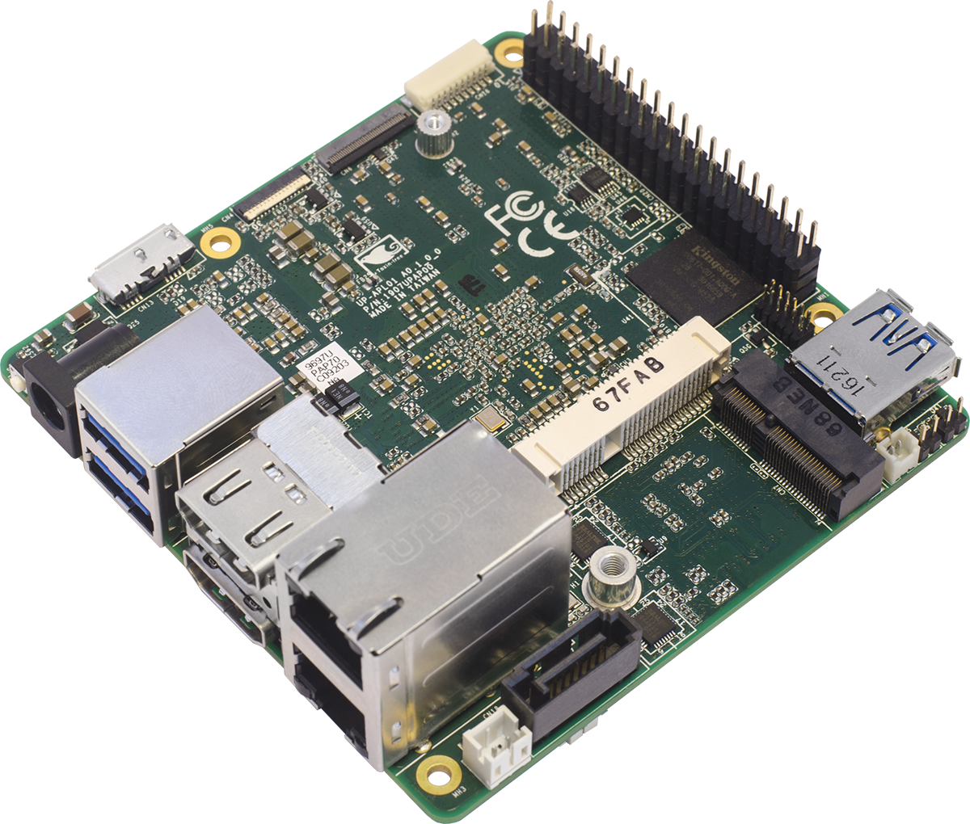
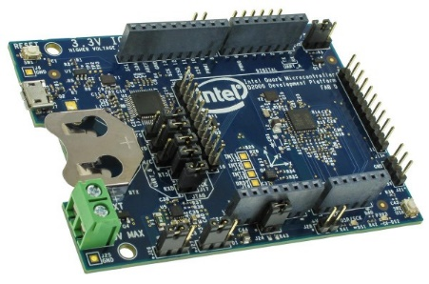
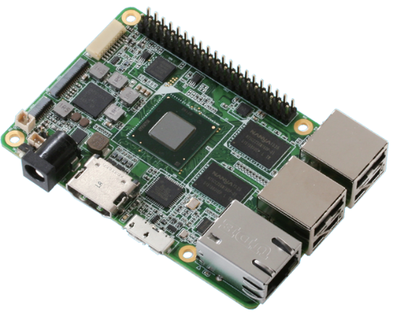

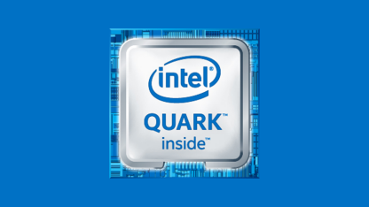
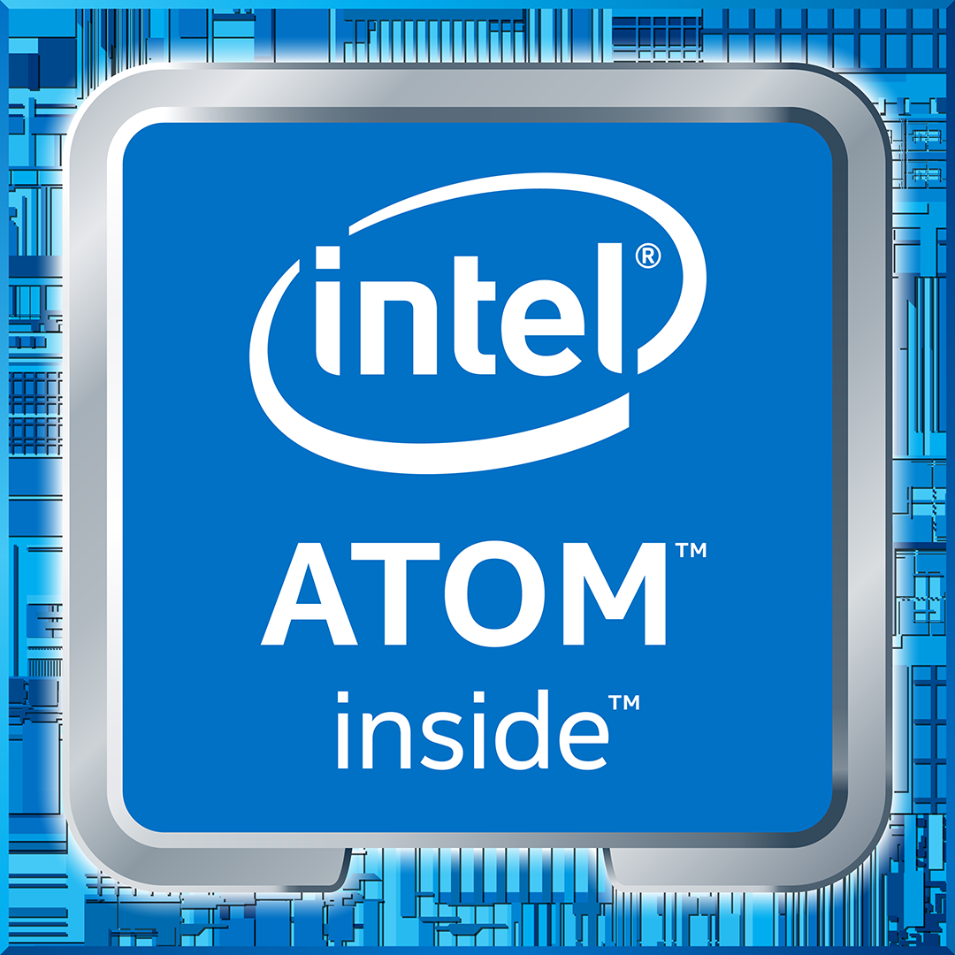
MRAA – I/O Library
Typical stack on UNIX systems:
Supports Intel, non-Intel (community added) MCU boards, UNIX boards and IoT Gateways
Simple I/O protocol control for:
Open source on GitHub:
http://mraa.io
GPIO
Analog (AIO)
PWM
SPI
I²C
UART
1-Wire
Firmata
Notes:
So I mentioned MRAA in the last slide, but I didn't really talk about what it is. MRAA is a C++ library, with bindings for both Javascipt and Python,
Is used to control low level sensor functionality. This means that you can access GPIOs, read/write to an I2C bus, or interface with a microcontroller board over Firmata amongst other low level interactions.
I also mentioned interoperability earlier. Well you can use MRAA across a huge range of platforms – Intel NUCs, the UP board, Minnowboard, or any other intel microcontroller, MRAA will even work with non intel boards like the rasperry pi, beagalebone, even a DE10-Nano which is an FPGA which runs an Altera cyclone SOC.
So for instance if you are developing a project on one board you can move across to something that fits better – even to a different architecture – and take your low level sensor control code with you.

Slide 9
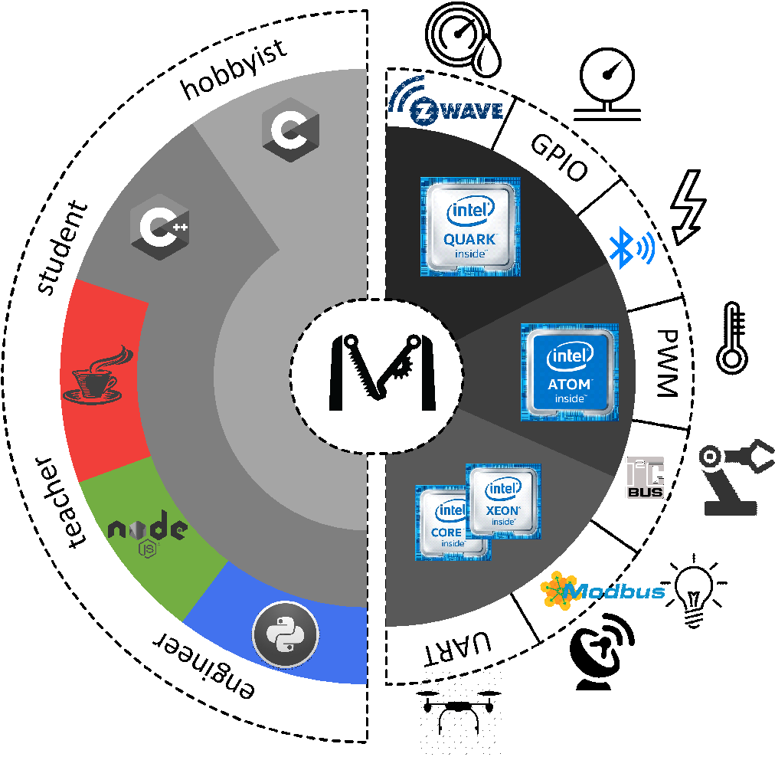
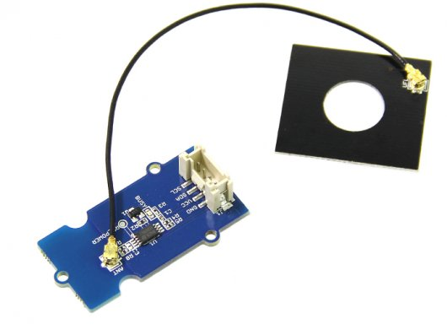
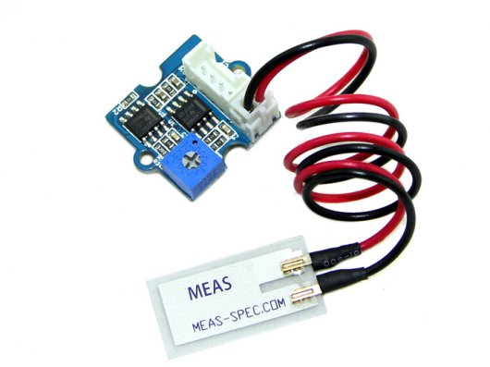
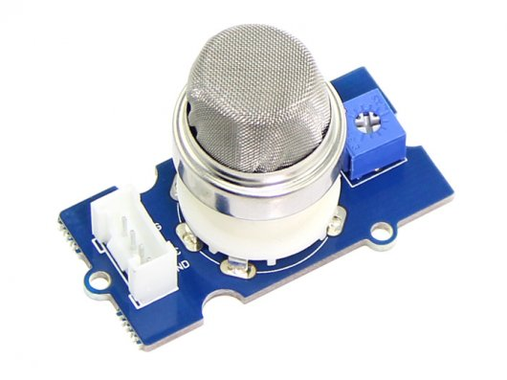
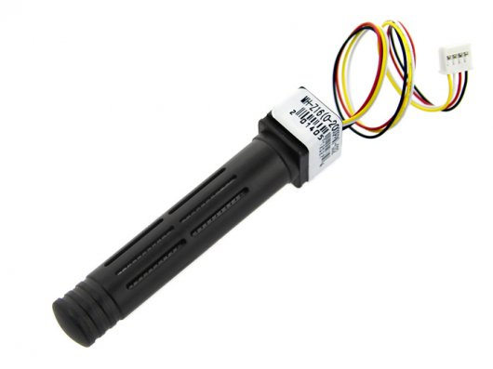
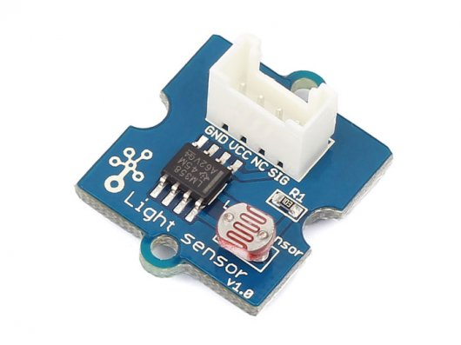
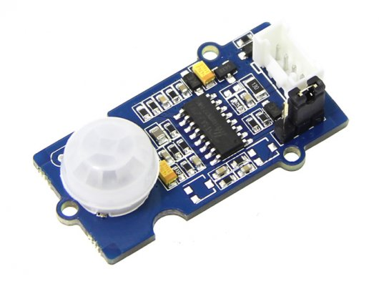

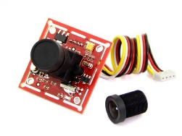
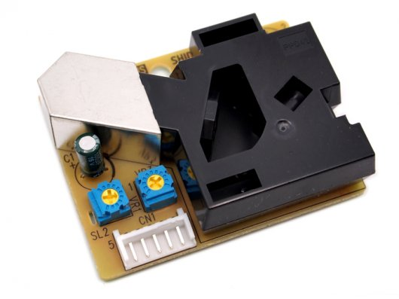
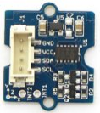
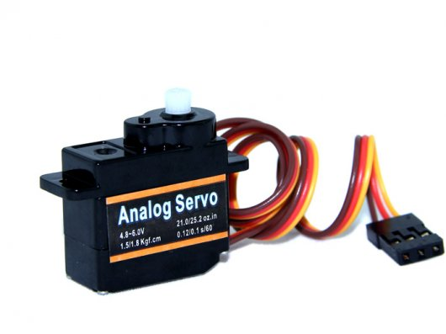
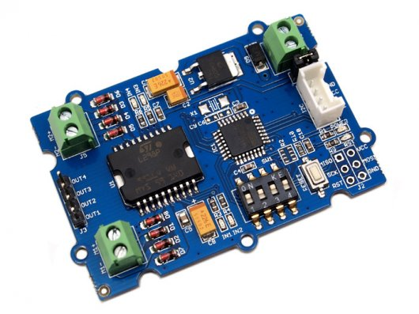
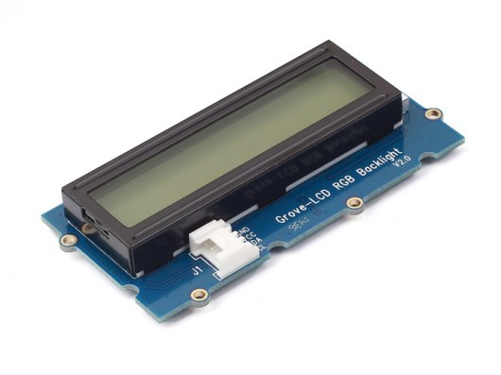
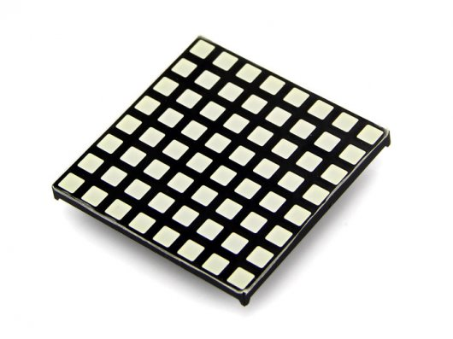
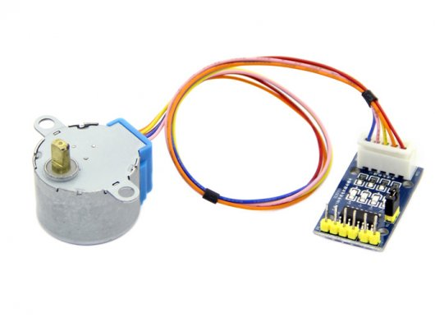
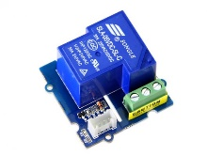
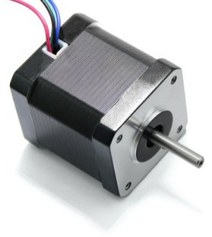
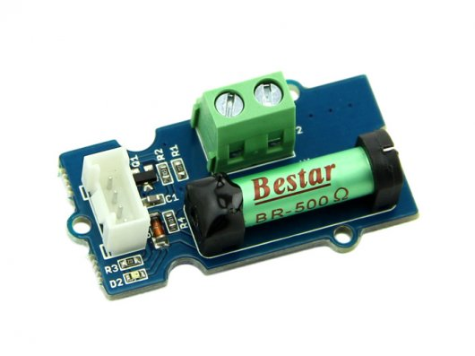
UPM – Sensor Library
Software suite for sensors, actuators, radios and protocols
Open source, Intel maintained, community supported:
http://upm.mraa.io
Sensors
Actuators
Notes:
Now, having these low level libraries is great, but as a developer its nice to have access to high level APIs as well. That’s where UPM – ore the Useful Packages and Modules - library comes in. UPM is built on top of the low level MRAA library and has high level api sensor support for over 300 sensors and acutators. These sensors are things like temperature, moisture, acceleration, magnetic field while actuators cover things like stepper motors, lcd displays, or just simple relays.
The sensors range from simple and inexpensive prototype sensors to more hardened industrial grade sensors. So with UPM you can develop a proof of concept quickly and then when you are ready to move to production you can swap out your prototype sensor with a commercial sensor and keep your same control code.

Slide 10
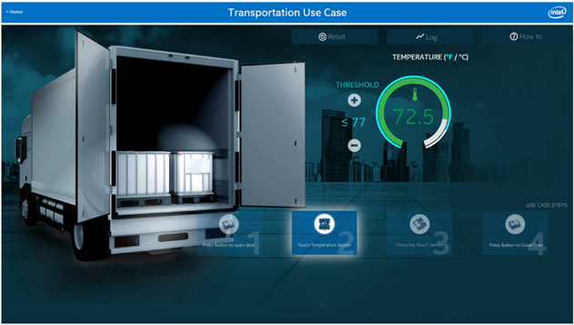
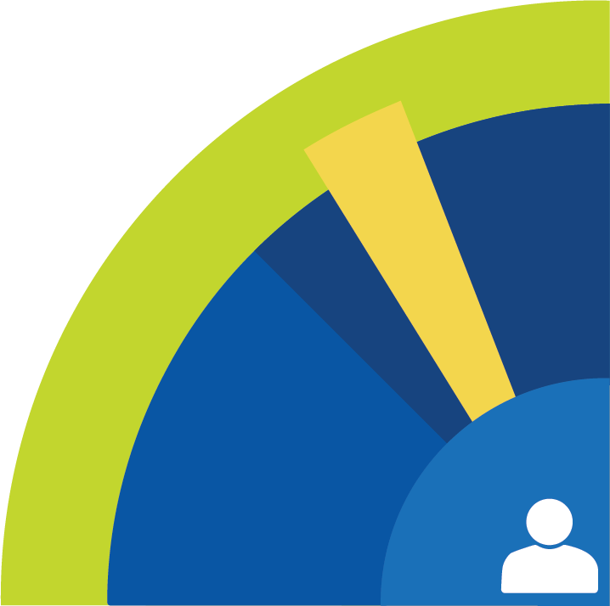
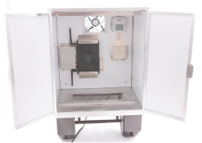
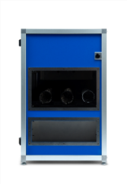



Code Samples
Code
Write your own or reuse sample code & packages for your own projects.
Code snippets
Mini projects
End to end solutions
End-to-end Reference Implementations
Transportation
Smart Home
Retail
Code
Notes:
If you want to start developing on the Intel platform you can find a ton of resources to get your project off the ground. There are code samples, proof of concept projects, full IoT solutions with descriptions and code. You can even find market research for certain IoT verticals like smart home, smart transportation, retail and more.
All of the code is open source so you can use whatever portions you want and not have to worry about licensing issues.

Slide 11
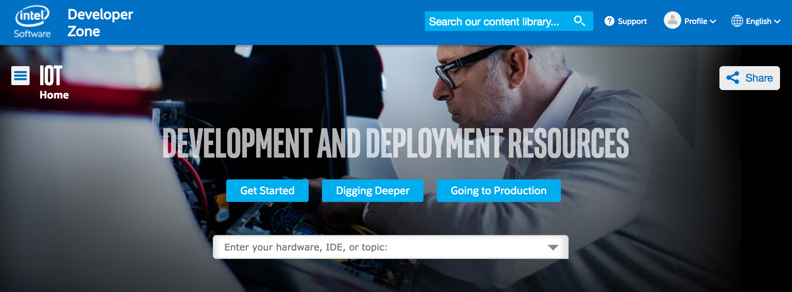
Intel Developer Program: Software.intel.com/iot
Notes:
So finally how do we tie all this together? Intel has created a hub for IoT developers at software.intel.com/iot. Here you can find all the software, hardware, IDEs, community forums, everything I talked about so far and much more. If you want to learn more about developing IoT with Intel this is a great place to start.

Slide 12
GCP Overview
Notes:
Ok so that was an overview of intel IoT, lets do a quick overview of Google Cloud Platform - the cloud service we will be looking at today.

Slide 13
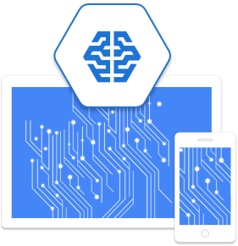
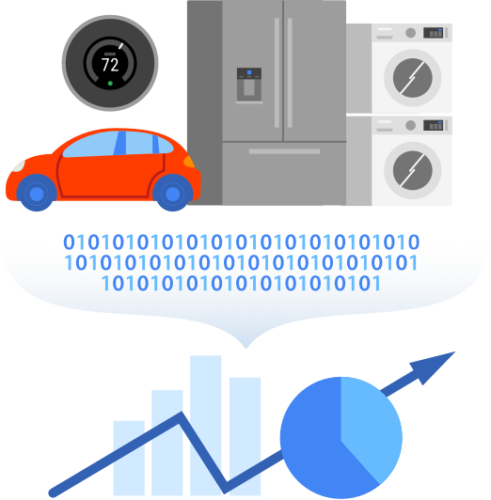
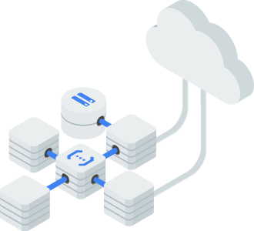
What is GCP?
Serverless Compute
Machine Learning
Internet of Things
Notes:
Google Cloud Platform is a suite of cloud computing services that runs on the same infrastructure that Google uses internally for its end-user products, such as Google Search and YouTube. It includes serverless compute services, machine learning frameworks, and internet of things

Slide 14
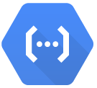

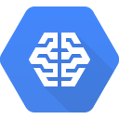





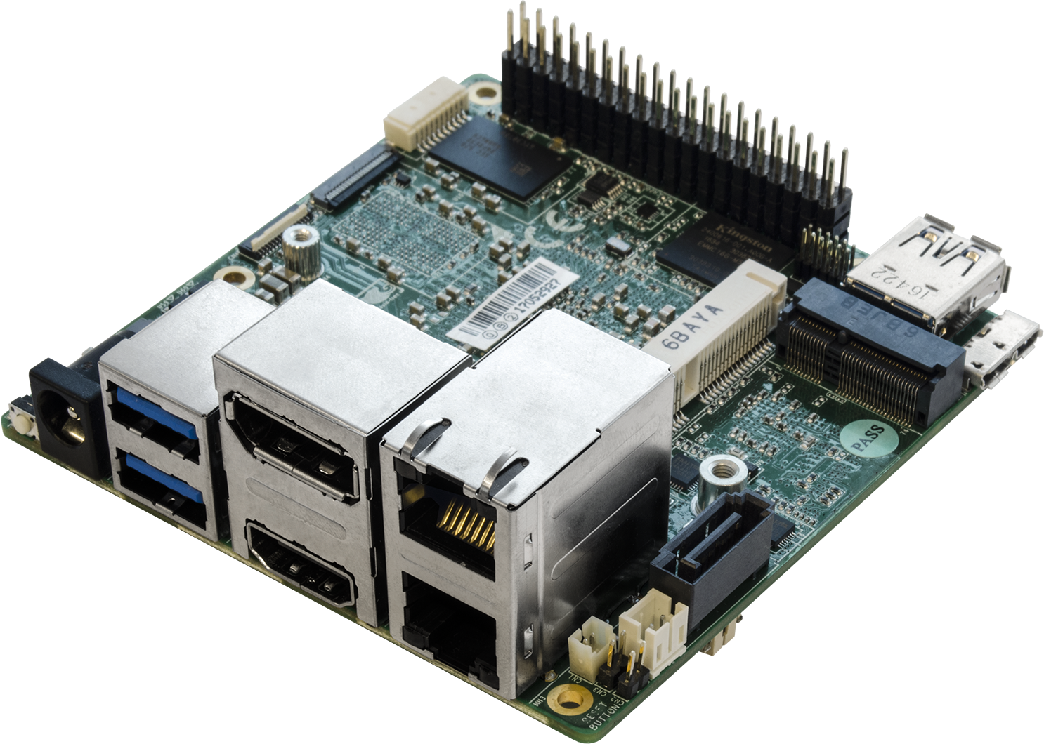





Cloud IoT Core
Cloud Functions
Cloud Pub/Sub
Cloud ML
Cloud IoT Core
Devices
Applications
Cloud
Dataflow
BigQuery
DataStudio
Notes:
In order to connect your devices to all of these services, and eventually to your application, Google has created the Cloud IoT Core. Cloud IoT Core is a fully managed service that allows you to easily and securely connect, manage, and ingest data from millions of globally dispersed devices. Cloud IoT Core, in combination with other services on Google Cloud IoT platform, provides a complete solution for collecting, processing, analyzing, and visualizing IoT data in real time.

Slide 15

Optimize device control with bi-directional dataflow
Notes:
Google Cloud IoT makes it easy for you to not only ingest and analyze data but to also close the loop by allowing you to update device configuration real-time. You can trigger a Cloud Functions job to evaluate a rule condition based on incoming IoT data stream from Pub/Sub or you can call a Machine Learning API from Dataflow to predict an outcome based on incoming data stream and send instructions back to the device through Cloud IoT Core.

Slide 16





Simple UI for monitoring and management
Cloud Platform
Notes:
All of this can be managed through the Google Cloud Platform console - a simple UI that gives you access to all of the GCP services and allows you to monitor your deployments.

Slide 17

Intel® IoT & Google cloud
Joint Reference Architecture: Intel IoT and Google Cloud
Source: https://cloudplatform.googleblog.com/2017/09/announcing-Cloud-IoT-Core-public-beta.html, https://www.intel.com/content/dam/www/public/us/en/documents/reference-architectures/seamless-edge-to-cloud-iot-reference-architecture.pdf
Notes:
Intel and Google have been working together to create a full end-to-end solution for IoT. With Intel you can have a gateway device that gathers sensor data, does edge compute, and establishes a secure connection to the cloud. With Google you can take that sensor data and create intelligence and applications.

Slide 18
Voice to Text
Notes:
So now that we have discussed the basics of Intel and GCP I hope you have a better idea of where these two companies stand in the IoT ecosystem.
Lets now look take a look at our first machine learning application - voice to text.

Slide 19

History
1950s – 10 words, Formants
1980s – 20,000 words, HMMs
2000s – Full Vocab – high error rate HMM + Neural Net
Modern – Full Vocab – low error rate LSTM
Notes:
The first functional voice to text systems were created in the 1950s. These systems relied on formants - or resonant characteristics of individual sounds. These systems were very limited and could only handle a vocabulary of 10 words or so from a single speaker. By the 1980s the systems had improved considerably with vocabularies of 20,000 words. These systems relied on “Hidden Markov Model” - a probabilistic model which looks at changes of sounds over time. This was the best known voice recognition model until the 2000s when it was first combined with neural nets and then replaced by them completely.
We are going to be implementing a modern HMM as well as a modern neural net model for voice to text in the demo today.

Slide 20


CMU Sphinx
“Phone” based
Probabilistic
Runs Locally
Hidden Markov Chain Model - assigns label to each unit in sequence based on probabilistic approach
Notes:
The HMM model that we will be looking at is the Sphinx framework developed at Carnegie Mellon University. This model detects individual “phones” - which are essentially quantized units of speech - “ay” “ee” “oh” “u”. It then combines these phones into individual words based off a probabilistic combination which is based off of both the phones themselves and other words that have been detected in the sentence.
We will be running Sphinx locally on the Intel Gateway - meaning it will not depend on having an active internet connection.

Slide 21



Using Sphinx
Input from audio .wav file
Call Sphinx function
Input from microphone
Notes:
In order to run Sphinx we will be using Python and the sphinx modules. You can either read in a prerecorded wav file or get input directly for a microphone. Once you have the audio source you can call “recognize sphinx” method to analyze it. Overall very simple, but it does get more complex as you adjust how the model works in order to fine tune your application.

Slide 22

Google Cloud Speech API
Neural Network
110 Languages
Restful API
Google Cloud SDK
Notes:
Now to contrast the local HMM model we will also be looking at the Google Cloud Speech API. This is an API at access the neural network that google has trained in order to recognize speech - the same network that “Ok Google” uses. It has support for 110 languages and you can access the API either using a restful API - HTTP requests - or the Google Cloud SDK. Overall its a very powerful tool, but requires your application to be connected to the internet in order to work.

Slide 23

Deep Learning / Neural Networks
Notes:
Before moving on I want to briefly talk about neural networks. Neural networks, and their application to voice recognition, is the reason why modern voice detection systems function orders of magnitude better than those of even 5-10 years ago. The topic of neural networks is massive and I don’t want to get to far down a rabbit hole, but here is basically how one operates:
You give the algorithm an array of “input nodes”
these nodes are combined at one or more layers of “hidden nodes”
When I say combined I am referring to a specific summation function which takes the value of incoming nodes and multiplies it by a “weight” associated with each node to node connection.
If that sum is above a certain threshold value – bias – the node passes its value on to the next, and so on until you get to a set of output nodes.
Now the magic happens when you give the algorithm a set of input AND a set of corresponding output nodes. When the algorithm has both the input and the expected output it can train all of those connections and biases.
Basically it adjusts all of the network weights until it can produce the output that you tell it to. Once it can do that, you give it an input without an expected value and hopefully it is able to do use its now trained network to determine what the output should be.
This system resembles how neurons pass electrical impulses along our brain network which is why it is referred to as a neural net.
By training a network what “hello” sounds like from 10,000 different speakers it can then detect “hello” when given a sound clip it has not heard before.

Slide 24


Using Cloud Speech API
Console Frontend
HTTP Request
Google Cloud SDK
Notes:
The great thing about the Cloud Speech API is that you do not need to have a deep understanding of how a neural network works to be able to utilize it. We will look at how you can do speech to text using the console front end, as well as the Google Cloud SDK for Python.

Slide 25
Sentiment Analysis and Content Classification
Notes:
So once you have translated a sound file into speech, you might want to have your application actually analyze what the person has said. This is where Sentiment analysis and content classification comes in and it it as the cutting edge of machine learning applications.

Slide 26




Text Analytics
Notes:
What do I mean by sentiment and topic? Basically given a body of text I want my application to tell me what the speaker is talking about: Race Cars, jets, or dinosaurs;
and how they feel about it - which given the selection of topics is probably super excited.

Slide 27
Neural Networks - LSTM
Long Short Term Memory
Type of RNN
Contextual Analysis
“Non Volatile Memory”
“I went to France… I learned how to speak french”
Notes:
So how is our application actually able to get this information out of our text body? The answer is a specific neural network called a LSTM - or long short term memory. This is a subset of a type of network called a “Recurrent Neural Network” or RNN. What the LSTM allows is the network to have a long term memory from iteration to iteration. If the information in a traditional neural network is looked as like volatile RAM, LSTM give the system a hard drive to store information on.
What this allows for is the network to have a greater contextual analysis. For instance let's say our LSTN is trying to predict the last word “french”. It would be able to leverage both the word “speak” that came right before, as well as the word “france” that came at some earlier time in the text.

Slide 28

Recurrent Neural Networks
Notes:
To get a better idea about the mechanism behind LSTMs let's take a quick look at how they work in principal. a single node in an RNN takes in an input X_t from other nodes, as well as an input from itself. this feedback input can be seen as propagating information through each iteration of the neural network - in this way having a memory from one run to the next.

Slide 29

LSTM Specific Structure
Notes:
the LSTM has two feedback loops - a long and a short term memory. These feedback loops are controlled through a system of activation functions - sigmoids and hyperbolic tangents, and the entire network can get fairly complex. The thing about using an LSTM for analysis is that you do not necessarily have to understand how the underlying systems work - you can be a proficient carpenter without understanding the metallurgic process that creates your hammer.

Slide 30

Pre Trained Model APIs
Rule #1 of ML: Don’t create model if you don’t need to
Cloud Natural Language API:
Grammatic Structure
Sentiment
Syntax
Catagories
Notes:
The first rule that I’ve heard from data scientists when it comes to neural networks is “don’t create your own model if you don’t need to”. The fact of the matter is that there are models have been developed for years and years, and specific ones have proven to be extremely good at specific tasks - so you will be best served by finding one that has a proven track record rather than try to create your own from scratch.
The other aspect of model creation is model training. I mentioned training as an integral part of a neural network earlier

Slide 31

Result of LSTM
“Google, headquartered in Mountain View, unveiled the new Android phone at the Consumer Electronic Show. Sundar Pichai said in his keynote that users love their new Android phones.”
Notes:
The result? let’s look at this example output from the Google Natural Language API. Based off of these two sentences the network has determined that the topics are “Computers and Electrons” “Internet and Telecom” and “News”. You can really see the power of this kind of network for automation.

Slide 32


Using Natural Language API
Web Based API
HTTP Request
Google Cloud SDK
Notes:
Similar to Cloud Speech API, you do not need to have a deep understanding of how a neural network works to be able to utilize the Natural language API. We will look at how you can analyze text using the console front end, as well as the Google Cloud SDK for Python.

Slide 33
demo!
code: https://github.com/priyanka-bagade/Innovator-training-Intel-Google-workshop
Notes:
Well now that we have an idea of how to do cloud compute at the edge and in the cloud, lets put it together into one demo and see how it can work in tandem!

Slide 34


GCP ML APIs
Speech to Text
Sentiment & Topic Analysis
Record Audio
Speech to Text
Connect to GCP
Receive Results
Notes:
This is how the setup looks like:
An intel i5 NUC running Sphinx, openCV and accesses Google Speech API and Google natural language API using Google cloud SDK for Python.
We attach a simple audio jack microphone to the NUC.
Sphinx library analyze audio from the connected microphone locally and converts it to text using HMM.
We send the same audio file to Google cloud by accessing Google Speech API for speech to text conversion.
The results are sent back to the console.
We then perform sentiment analysis and content clssification on the text obtained from Google Speech API using Google natural language API. The results are sent back to the console.

Slide 35

Results
Speech recognition: Sphinx, Google Cloud Speech API
Text Analysis: Google natural language API
Audio input: An IoT gateway is an intermediate device between sensors and devices and the applications that create value from their data and access.
Notes:
and here are the results!
First we run the python script for speech recognition. When it displays, “Say something”, we talk in the microphone. For, this particular test, the audio input was “An IoT gateway is an intermediate device between sensors and devices and the applications that create value from their data and access.”. It is then processed by the sphinx library locally. You can see that how much the output text is deviated from the input audio.
Then we sent the same audio input to Google speech API which recognized the speech correctly. Also if we look at the time taken for both the analysis techniques, the Google speech API took less time with more accurate results.
The huge difference in the output text for sphinx is due to minimal training database. The HMM model used by sphinx library has very limited states which takes into account very limited sounds, ae, au, aa. On the other hand Google Speech API model (tensor flow model) has been trained for hours, on humongous data to cover almost all possible sounds for the words/letters.
To test Google natural language API, we sent the text from Google speech API to Google natural language API to do sentiment analysis and content classification. From the results, you can see that, sentiment analysis gave us 2 values, score and magnitude. The score of a document's sentiment indicates the overall emotion of a document. The magnitude of a document's sentiment indicates how much emotional content is present within the document, and this value is often proportional to the length of the document.
For this particular example, magnitude is 0.1 which indicates that the document includes very less emotional content. Score value -0.1 indicates the content is slightly negative.
The NL classifies the text and says that it’s from “computer and Electronics” with 87% confidence.

Slide 36
Questions?

